Slide 1
Conducted EMI from CFL Ver 1.0
19-03-2014

Slide 2
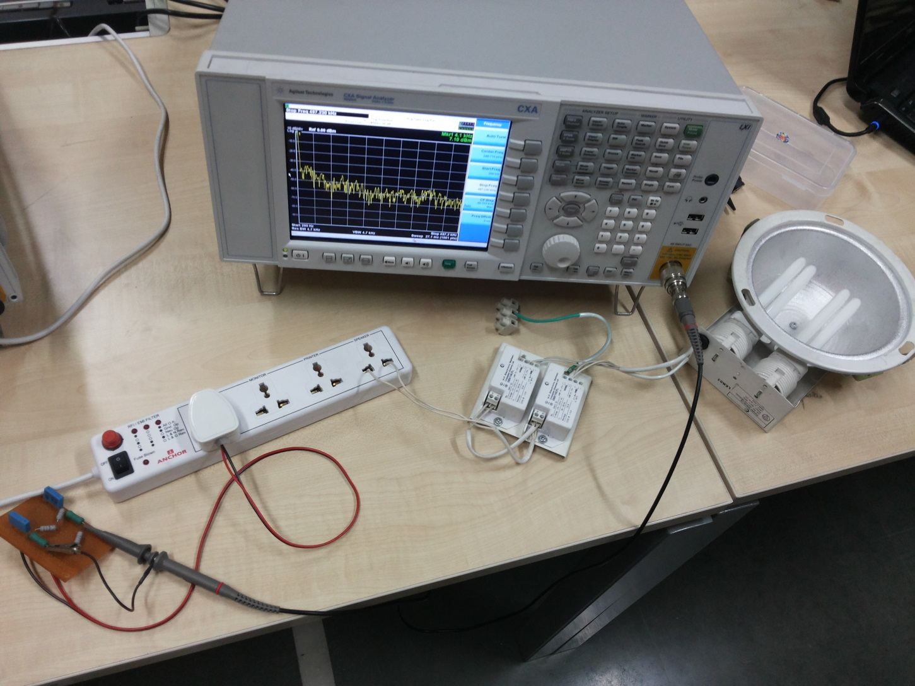
Measurement setup

Slide 3
Observation Range
Input Attenuator 10 dB
Start Freq. 100Hz
Stop Freq. 1Mhz
Center Freq. 500.050KHz

Slide 4
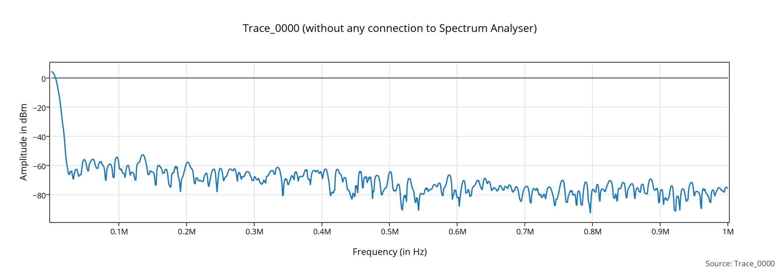
Trace_00 without any connection to SA

Slide 5
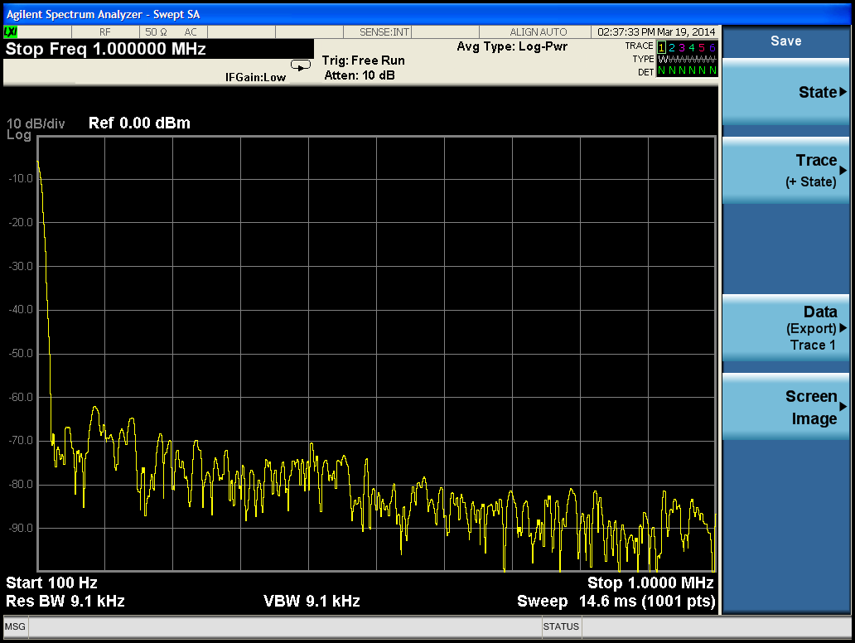
Trace_00 on SA

Slide 6
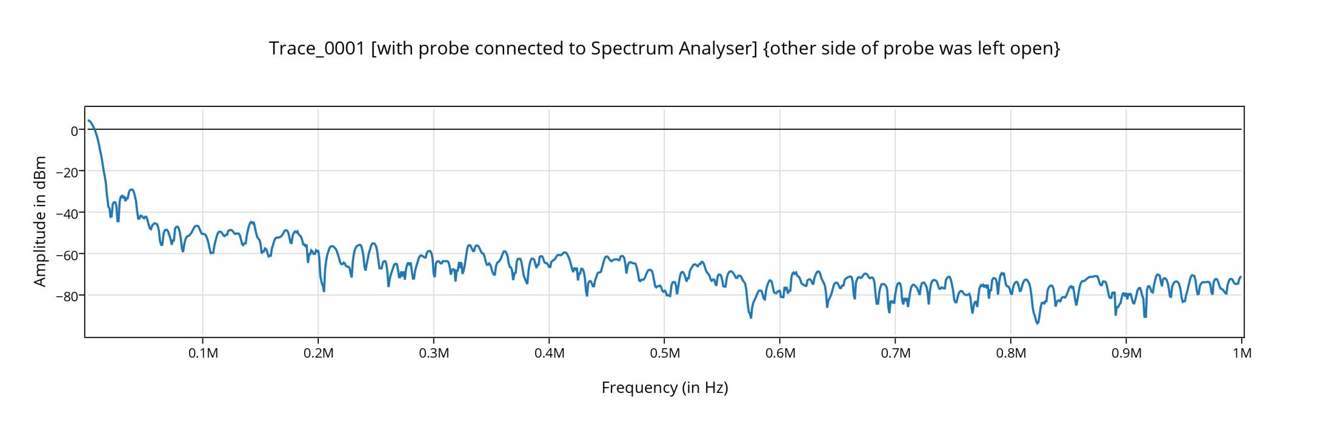
Trace_01 with probe connected to SA (other end of probe was left open)

Slide 7
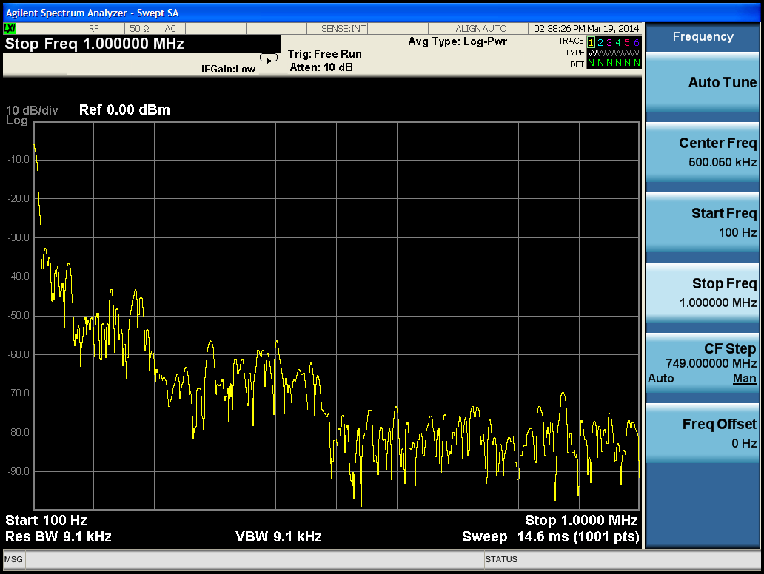
Trace_01 on SA

Slide 8
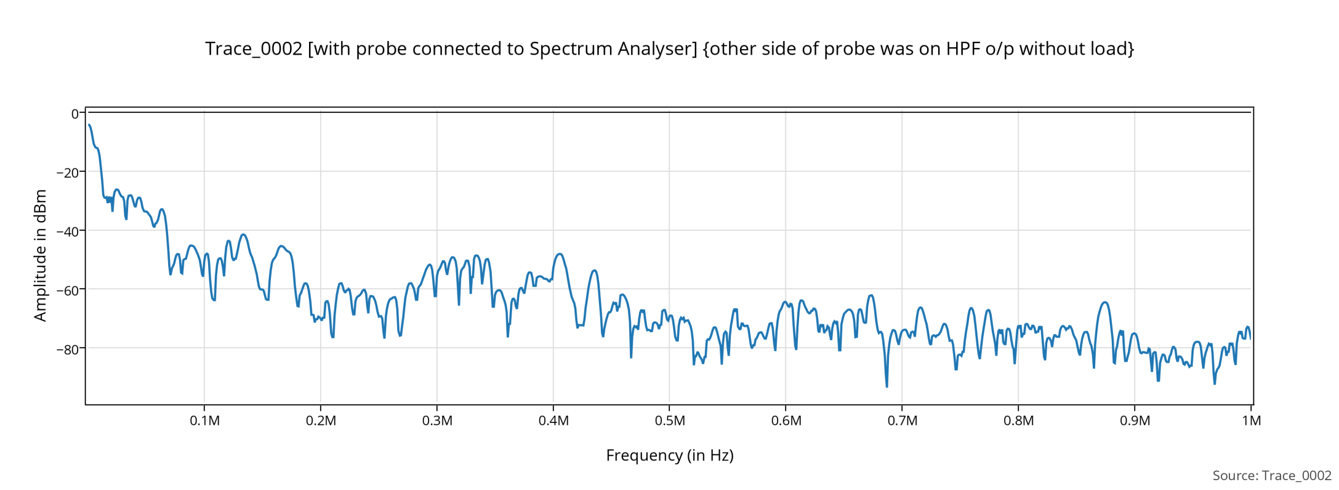
Trace_02 with probe connected to SA (other end of probe was connected to HPF o/p w/o load)

Slide 9
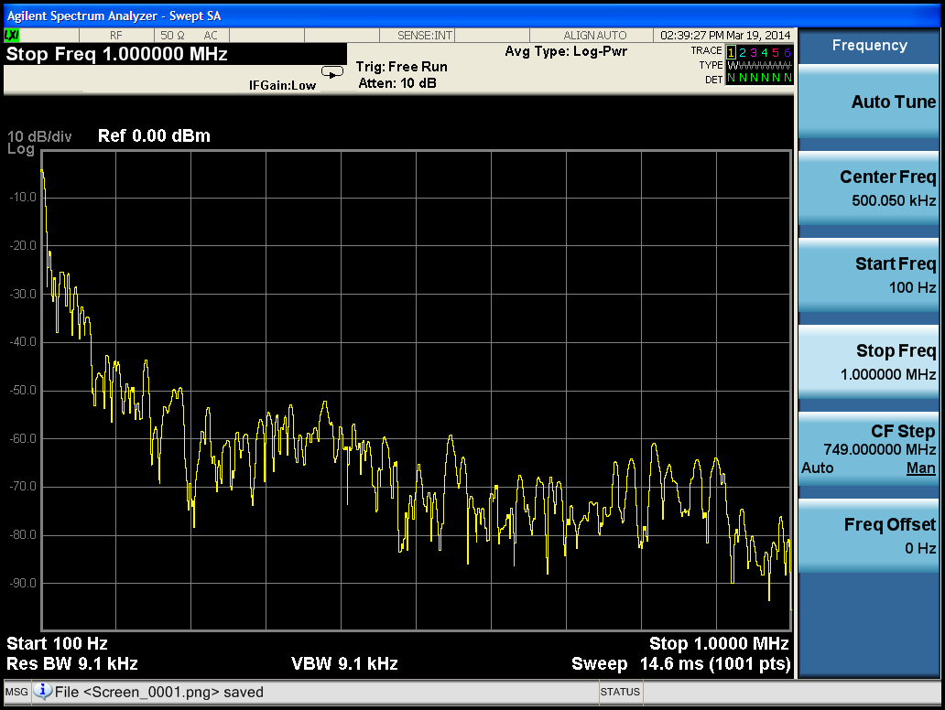
Trace_02 on SA

Slide 10
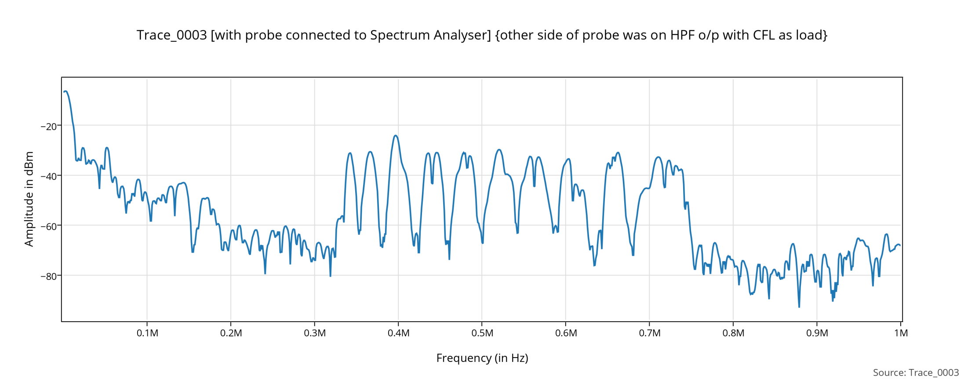
Trace_03 with probe connected to SA (other end of probe was connected to HPF o/p w/ CFL load)

Slide 11
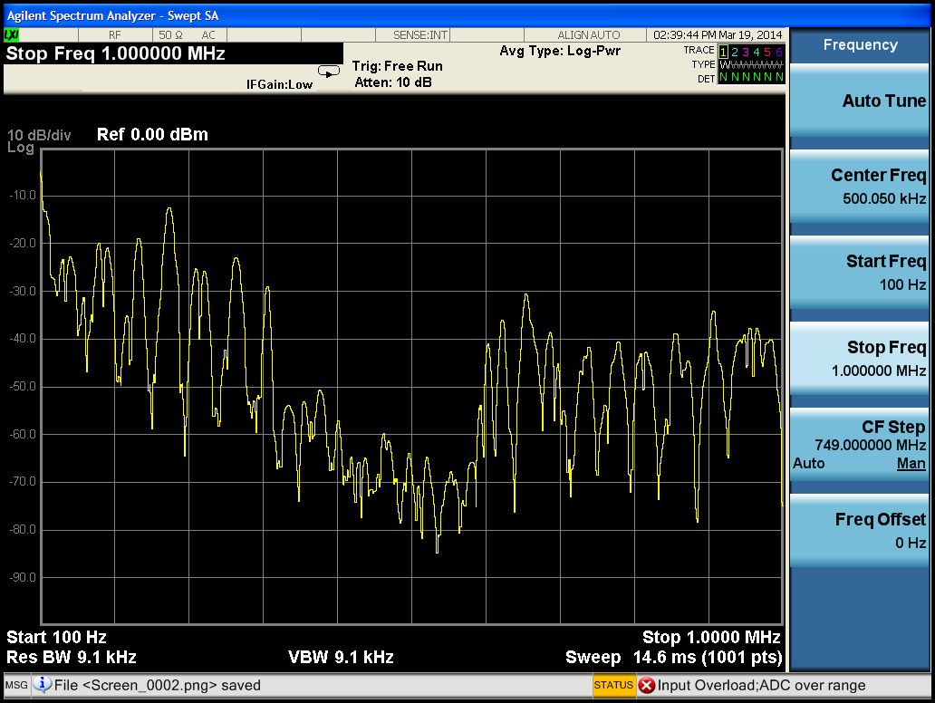
Trace_03 on SA

